Slide 1


SAP BTP CPI Training

Slide 2

DISCLAIMER
The training content and delivery of this presentation is confidential, and cannot be recorded, or copied and distributed to any third party, without the written consent of Anubhav Trainings

Slide 3


Introduction

Slide 4
Agenda
Mail Adapter
Data Store
Select
Write
Delete
Get
Write variable
Data Store Adapter

Slide 5
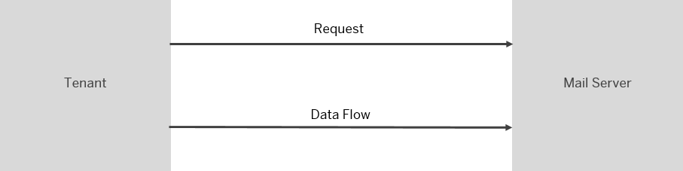
MAIL ADapter
This adapter exchanges data with a remote component that might be outside the scope of SAP. Make sure that the data exchange complies with your company’s policies.
The mail receiver adapter opens a connection to a mail server and sends messages (as e-mail) to it.

Slide 6
Once you've created a receiver channel and selected the mail receiver adapter, you can configure the following attributes.

Slide 7
MAIL
Parameter | Description
Address | Specifies the host name and (optionally) a port number of the SMTP server.An external mail server can be used. Use one of the following open ports for external mail servers: 587 for SMTP+STARTTLS 465 for SMTPS Example (to connect to Yahoo mail server): smtp.mail.yahoo.com:465 Note If no port is specified in the Address field, by default port 25 is used. This is not recommended. Recommended ports are 587 for SMTP+STARTTLS and 465 for SMTPS.
Proxy Type | The type of proxy that you’re using to connect to the target system. Select Internet if you’re connecting to a cloud mail server. Select On-Premise if you’re connecting to an on-premise mail server. For more information, see Using SAP Cloud Connector with Cloud Integration Adapters.
Location ID (only if On-Premise is selected for Proxy Type) | To connect to a cloud connector instance associated with your account, enter the location ID that you defined for this instance in the destination configuration on the cloud side.
Timeout (in ms) | Specifies the network timeout for the connection attempt to the server.The default value is 30000. The timeout must be larger than 0, but less than five minutes.
Protection | Defines whether encryption is used. The possible values are:Off No encryption is initiated, whether the server re

Slide 8
Processing
Parameter | Description
From | E-mail address that the message comes from.
To | E-mail address that the message is sent to.If you want to configure multiple mail receivers, use a comma (,) to separate the addresses. Example: name1@example.com, name2@example.com, name3@example.com
Cc | Additional e-mail addresses that the e-mail is to be sent to.These addresses are visible to the receiver. If you want to configure multiple mail receivers, use a comma (,) to separate the addresses. Example: name1@example.com, name2@example.com, name3@example.com
Bcc | Additional e-mail addresses that the e-mail is to be sent to.These addresses aren’t visible to the receiver. If you want to configure multiple mail receivers, use a comma (,) to separate the addresses. Example: name1@example.com, name2@example.com, name3@example.com
Subject | Subject of the e-mail message.
Mail Body | Specifies the text of an e-mail message.As default entry, the following expression is set: ${in.body} If you keep the default setting, the message body (as determined by this dynamic expression) is sent to the receiver.
Body MIME Type | Specifies the type of the message body. This type determines how the message is displayed by different user agents. You can select from the following MIME types: Text/Plain (default setting) Text/CSV Text/HTML Application/XML Application/JSON Application/Octet-Stream Application/ZIP Application/X-Gzip

Slide 9
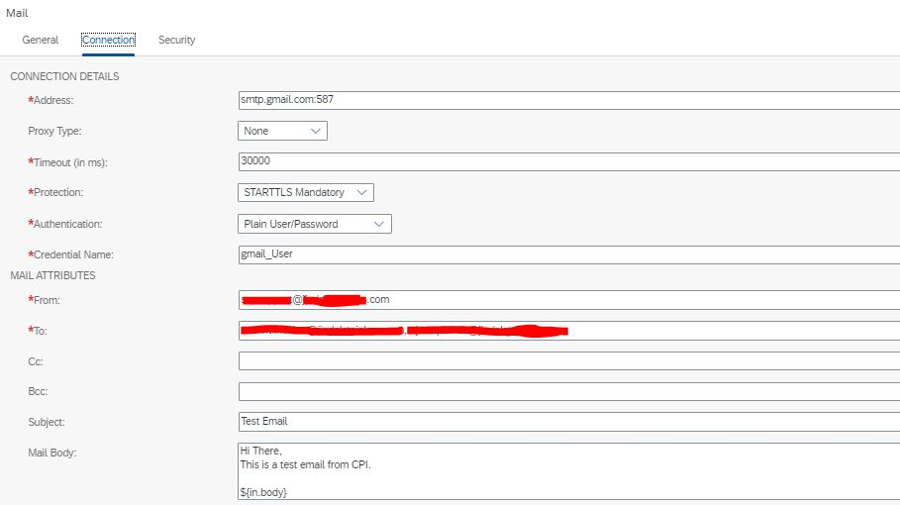

Slide 10
Gmail integration with SAP CPI
Step 1: Setting Up the App Password.
Create & use App Passwords
If you use 2-Step-Verification and get a "password incorrect" error when you sign in, you can try to use an App Password.
Go to your Google Account.
Select Security.
Under "Signing in to Google," select App Passwords. You may need to sign in. If you don’t have this option, it might be because:
2-Step Verification is not set up for your account.
2-Step Verification is only set up for security keys.
Your account is through work, school, or other organization.
You turned on Advanced Protection.
At the bottom, choose Select app and choose the app you using Select device and choose the device you’re using Generate.
Follow the instructions to enter the App Password. The App Password is the 16-character code in the yellow bar on your device.
Tap Done.
Tip: Most of the time, you’ll only have to enter an App Password once per app or device, so don’t worry about memorizing it.

Slide 11
To setup the App Password, login to your Google Account and click the ‘Manage your Google Account’ button. It should be located at the top right corner. At your ‘Google Account’ page, click the ‘Security’ link located on your left. You will see the ‘App Passwords’ link inside the ‘Signing in to Google’ box.

Slide 12
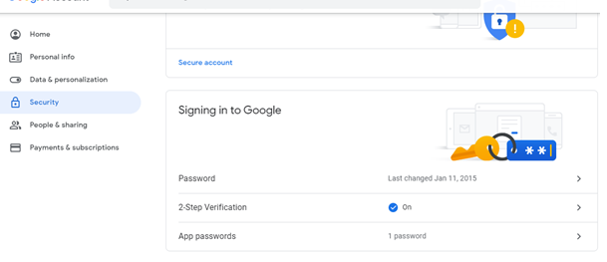

Slide 13
After clicking the ‘App password’ link, you may start creating an App Password. As shown in the figure below, select ‘Other (Custom Name)’ under the ‘Select App’ drop-down and click ‘Generate’.

Slide 14
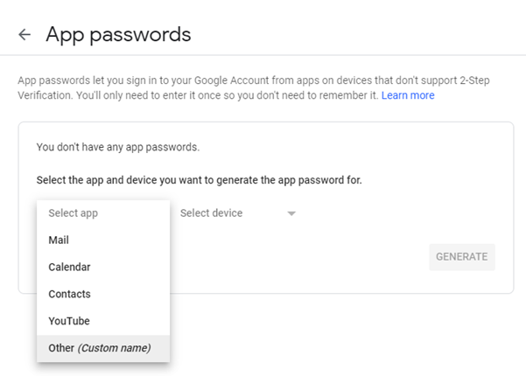

Slide 15
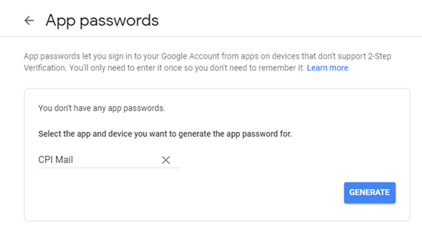
Enter the name of your choice and in my case, I have entered ‘CPI Mail’, as shown in the below figure. Click ‘Generate’.

Slide 16
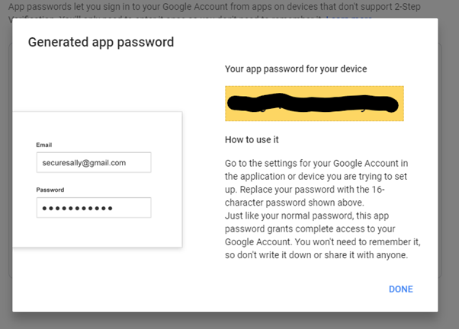
You will see your new 16-character App Password in the ‘Generate app password’ page, as shown in the figure below. Copy this password.

Slide 17
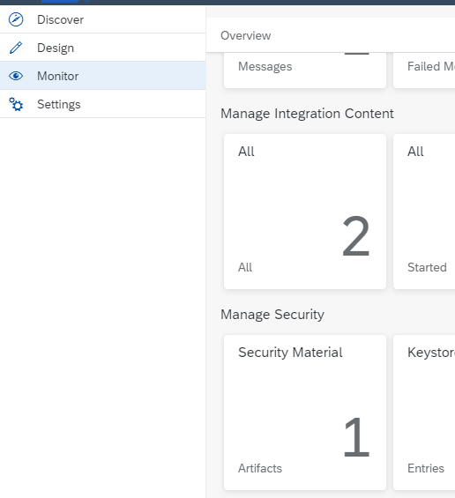
Step 2: Setup Credential in CPI.
In your SAP Cloud Platform Integration’s Overview page, click ‘Monitor’, as shown in the figure below. Then, click on the ‘Security Material’ tile.

Slide 18
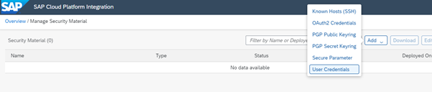
In the ‘Manage Security Material’ page, select ‘Add’, then ‘User Credentials’, as shown in the figure below.

Slide 19
In the ‘Add User Credentials’ screen, enter a name of your choice. In my case, it was ‘GMAIL_CREDENTIAL’. Enter the Description and select ‘User Credentials’ as Type. Enter your full Gmail account user name at the ‘User:’ textbox.
Lastly, paste the 16-character App Password into the ‘Password:’ and ‘Repeat Password:’ textboxes.
Click ‘Deploy’.

Slide 20
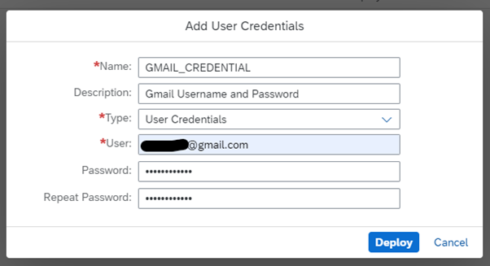

Slide 21
Step 3: Import Google Certificates
This step allows the Gmail SMTP server to authenticate itself against SAP Cloud Platform Integration.
At your SAP Cloud Platform Integration’s Overview page, click ‘Monitor’ and then click the ’Connectivity Tests’ tile, which is located under the ‘Manage Security’ section. In the ‘Test Connectivity’ page, click ‘SMTP’ and enter the details as shown in the figure below. Ensure that the ‘Credential Name’ is the same as what you entered previously in the ‘Manage Security Material’ page. Then, click ‘Send’ and you should see the green successful response. Click the ‘Download’ button to download the certificates into your computer.
Lastly, once in your computer, unzip the certificate file.

Slide 22
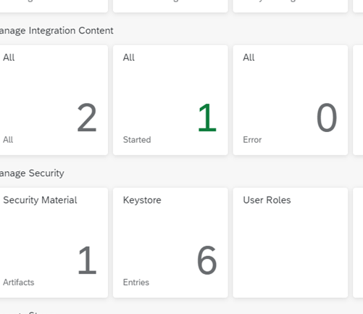
Step 4: Install the certificates on CPI
At your SAP Cloud Platform Integration’s Overview page, click ‘Monitor’ and then click the ’Keystore’ tile, which is located under the ‘Manage Security’ section.

Slide 23
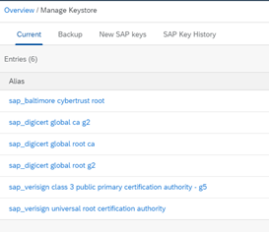
In the ‘Manage Keystore’ page, click ‘Add’, then ‘Certificate’, as shown in the figure below.

Slide 24
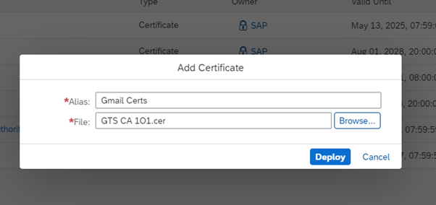
In the ‘Add Certificate’ page, enter the ‘Alias’ of your choice (in my case, it is ‘Gmail Certs’). Select the certificate from your PC and click ‘Deploy’.

Slide 25
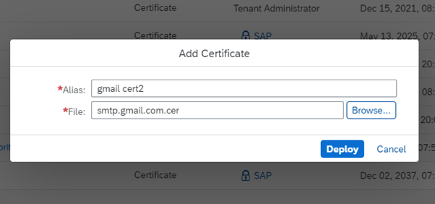
Repeat the addition of the second certificate, as shown in the figure below.

Slide 26
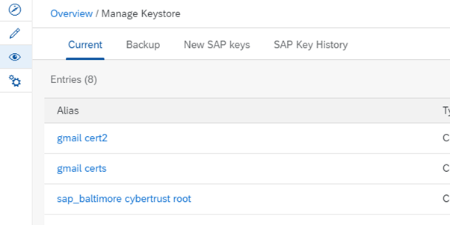
Once done, you will see two additional entries in the ‘Manage Keystore’ listing. In my case, they are ‘gmail certs’ and ‘gmail cert2’, as shown in the figure below.

Slide 27
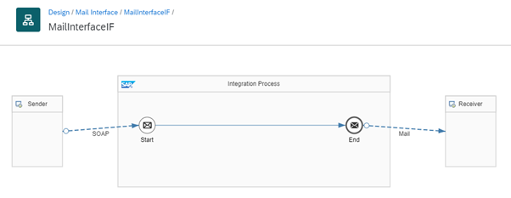
Step 5: Create and Deploy the Integration Flow
Now, you may design and deploy the iFlow.
Below is my simple iFlow for testing

Slide 28
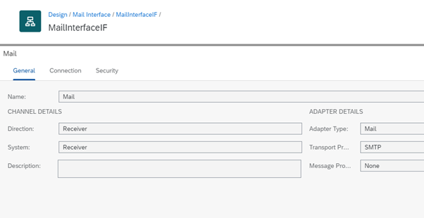
Below is the configuration in the ‘General’ Tab

Slide 29
And here is the configuration in the ‘Connection’ tab. Please ensure that you enter the same value in the ‘Credential Name:’ textbox, as what you have previously created in ‘Step 2: Setup Credential in CPI.’.

Slide 30
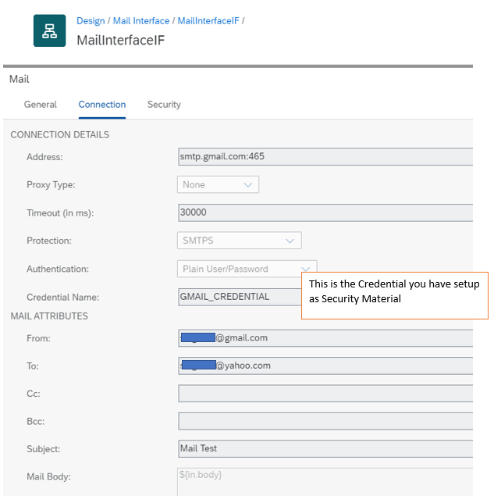

Slide 32
Step 6: Testing the Integration Flow

Slide 35
Data Store
Datastores are the objects that connect SAP Cloud Integration for data services to your cloud and on-premise applications and databases. Through these connections, SAP Cloud Integration for data services can access metadata from and read and write data to your applications and databases.
Create Data Store
Create a datastore for each application or database you want to connect to SAP Cloud Integration for data services.
In the web UI, click on the Datastores tab.
Click the + icon in the upper left-hand corner.
In the New Datastore dialog, configure the necessary fields.The configuration options change according to the datastore typ
Click Save to create the datastore.

Slide 36
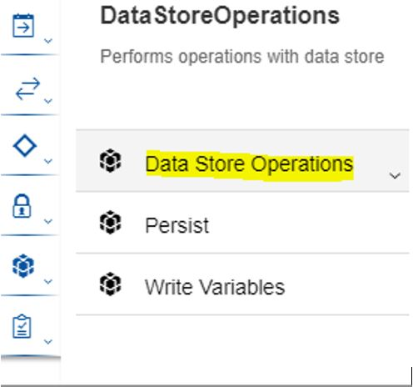
Data Store
From the palette menu, select the DataStoreOperations to find the different controls Delete/Get/Select/Write.

Slide 37
Write operation
Create an iflow ‘zflow’ as below. To keep it simple I am just passing an xml file (with 2 records) through SFTP and in ContentModifier step the body of the incoming payload is been passed as-is to the next control step ‘Write’. On the receiver side, I am creating an xml file in the SFTP location using the incoming payload.
In the ‘Write’ control step select ‘Global’ for the parameter ‘Visibility’ so that the message stored is visible to other iflows.

Slide 38
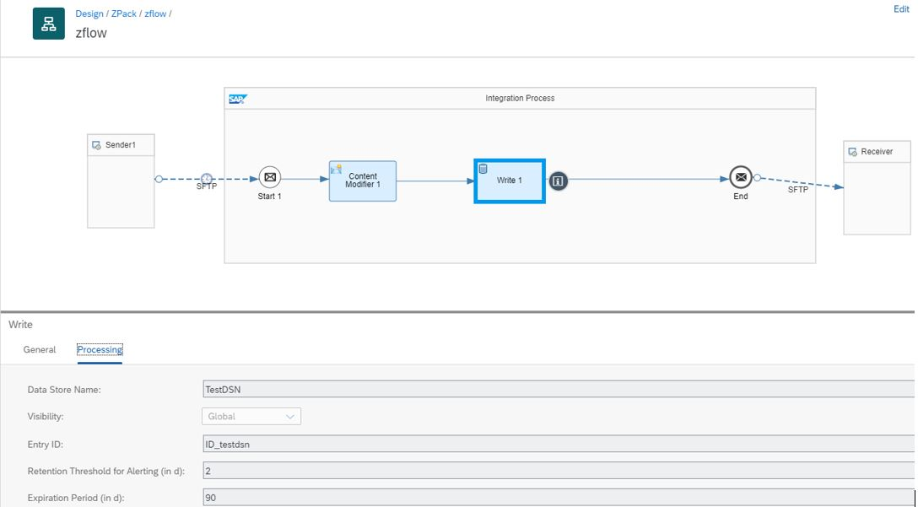
In the ‘Write’ control step select ‘Global’ for the parameter ‘Visibility’ so that the message stored is visible to other iflows.

Slide 39
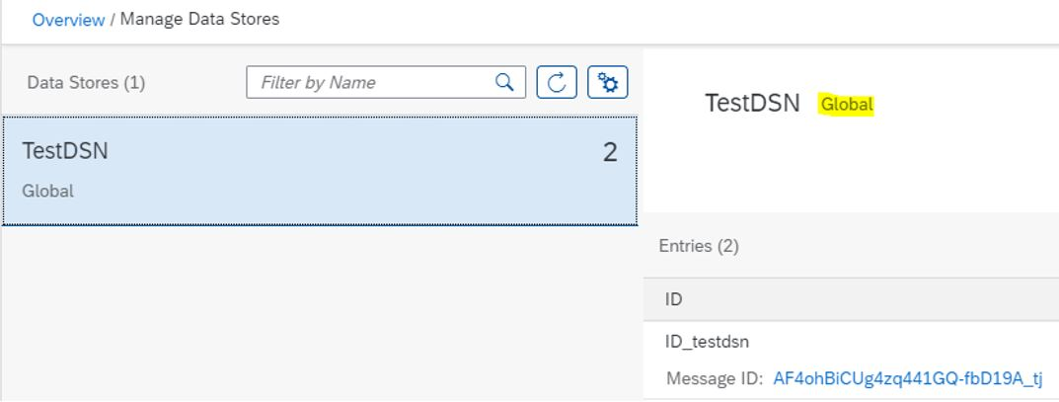
Data Store
Once the iflow is deployed, we can goto path Overview->Manage Data Stores, and check that a new data store has been created in the tenant.

Slide 40
Data Store
GET operation
Create a new iflow ‘zflow1’ as below. In this scenario pass a different xml file (with 1 record) through sender SFTP adapter. The content modifier will pass the incoming payload as-is to the ‘GET’ operation.
In the ‘GET’ operation step, provide the data store name that was created in the tenant by the ‘Write’ operation.

Slide 41
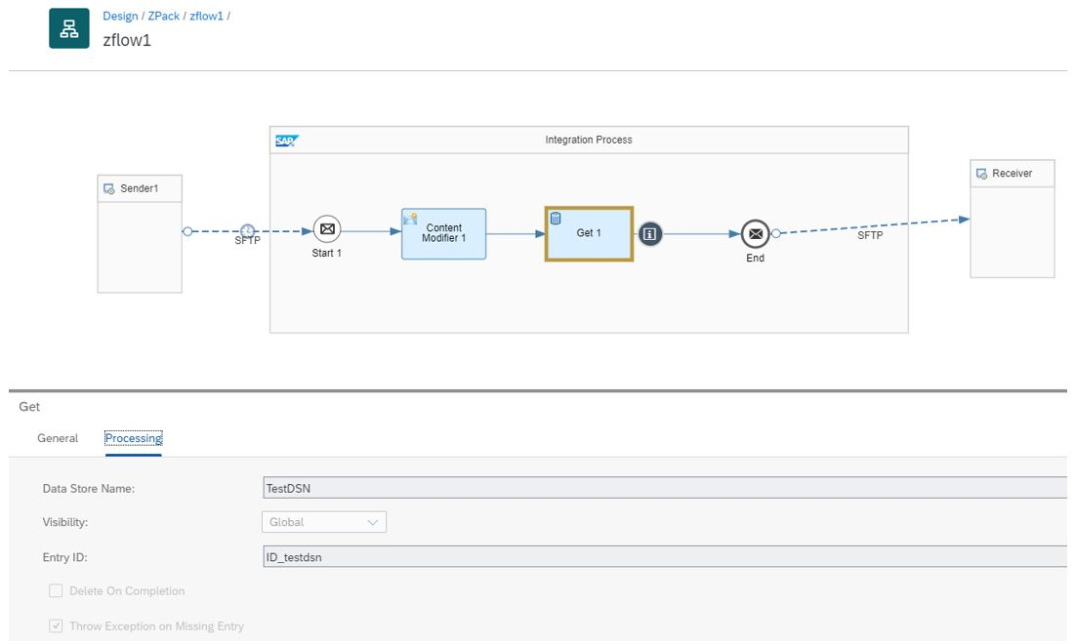

Slide 42
Select operation
We create a new iflow ‘zflow_select’ as below with similar steps as in previous section and use the ‘Select’ operation from the control’s palette.

Slide 43
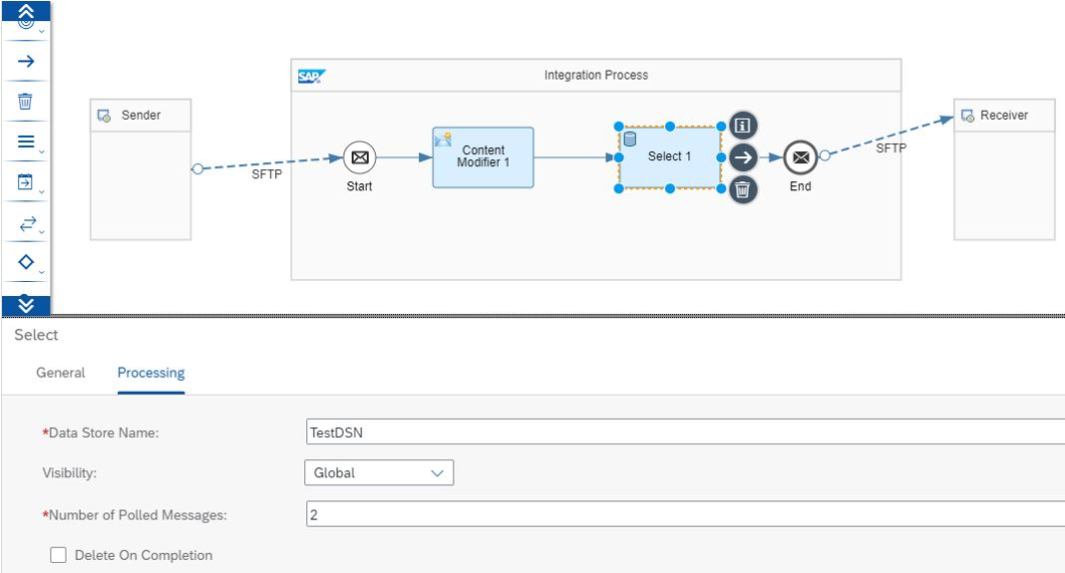

Slide 44
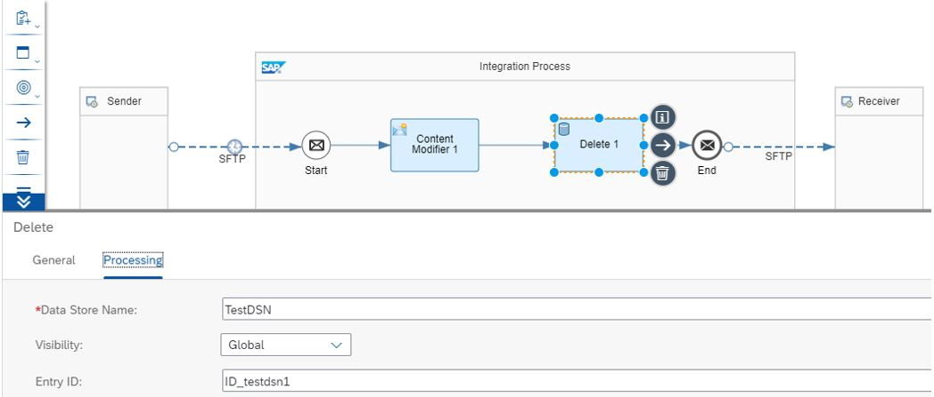
Delete operation
I created a new iflow ‘zflow_del’ as below with same steps as provided in previous sections and added a ‘Delete’ operation from the control palette.

Slide 45
Data Store Operations
Operation | Used to ...
Write | Store the messages temporarily in the data store. If you use a Write operation, you can store the messages in the data store by configuring the data store name and a unique Entry ID. More information: Define Data Store Write Operations
Delete | Trigger the deletion of messages in the data store. More information: Define Data Store Delete Operations
Select | Fetch messages in bulk from the data store. You can also specify the maximum number of messages you fetch in each poll. More information: Define Data Store Select Operations
Get | Fetch a specific message from the data store. From component version 1.5 onwards, the Created At (header: SAP_DataStoreCreatedAt) and Retain Until (header: SAP_DataStoreExpiresAt) timestamps of the data store entry are included in the message. More information: Define Data Store Get Operations

Slide 46

Summarize
LET’S SUMMARISE!

Slide 47

Summarize
End of Day 1

Slide 49


We’re committed to empower you to be
#FutureReady
through powerful training solutions.
We build the workforce of the future.
250+
Corporate Clients
30,000+
Learners Trained
25000+
Learners Placed
FREE WEBINARS
Sign up for free webinars with industry experts every fortnight!
Enroll Now!
Contact us today!
https://anubhavtrainings.com

